Slide 1

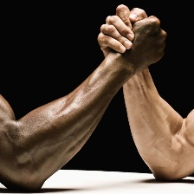
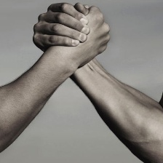
CSE445 Section 6
Generating Prototype Images of Notable Figures Using GANs
Exploring GANs to Generate Realistic Images for Artists, Actors, Athletes, Writers, and Scientists
Syeda Ramima Rafsana Nadia 2012863042
Ahanaf Tahomid 1831920642

Slide 2
Project Overview
Objective:
To generate realistic prototype images of notable figures using GANs.
Categories:
Artists, Movie Actors, Athletes, Writers, Scientists.
Approach:
Use Deep Convolutional GAN (DCGAN) to train and produce images.
Tools: TensorFlow, Python.

Slide 3
Goals and Objectives
Data Collection and Preparation:
Curate a dataset of notable figures across diverse professions.
Model Training with GANs:
Implement and train a DCGAN for image generation.
Evaluation and Fine-Tuning:
Assess generated images and refine the model.

Slide 4
Dataset Collection
Sources:
Kaggle, ImageNet, publicly available datasets.
Professions:
Images categorized into Artists, Actors, Athletes, Writers, Scientists.
Preprocessing:
Resizing: Standardized to 64x64 pixels.
Normalization: Pixel values scaled to [-1, 1].

Slide 5
GAN Model Architecture
Generator:
Converts random noise vectors into images.
Uses upsampling layers and convolutional operations.
Discriminator:
Identifies real vs. generated images.
Implements convolutional layers for image classification.

Slide 6
Training Process
Generator creates images from random noise.
Discriminator evaluates real vs. fake images.
Alternating updates to both networks for continuous improvement.
Challenges during training:
Stability of GANs.
Mode collapse mitigation through parameter tuning.

Slide 7
Future Work
Enhance training with StyleGAN or Progressive GAN for better image quality.
Experiment with larger datasets and diverse inputs.
Evaluate outputs using Frechet Inception Distance (FID) and Inception Score (IS).
Expand categories to include broader professions or historical figures.

Slide 8
Expected Outcomes
Realistic, high-quality images representing each category.
Prototype images capturing key traits of artists, athletes, scientists, etc.
A robust model capable of generalizing across diverse datasets.

Slide 9
Conclusion
GANs provide a powerful framework for generating synthetic images.
The project lays a foundation for image synthesis across multiple domains.
Future improvements will focus on refining model accuracy and output quality.

Slide 10
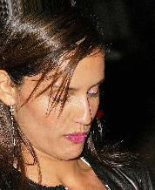
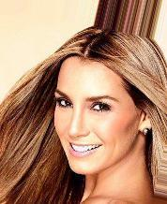
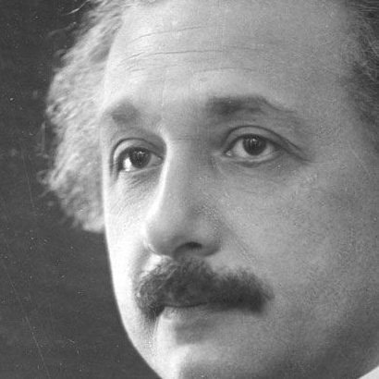
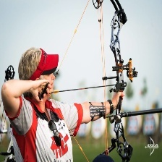
Dataset Overview

Slide 11








Generated Image

